Slide 1
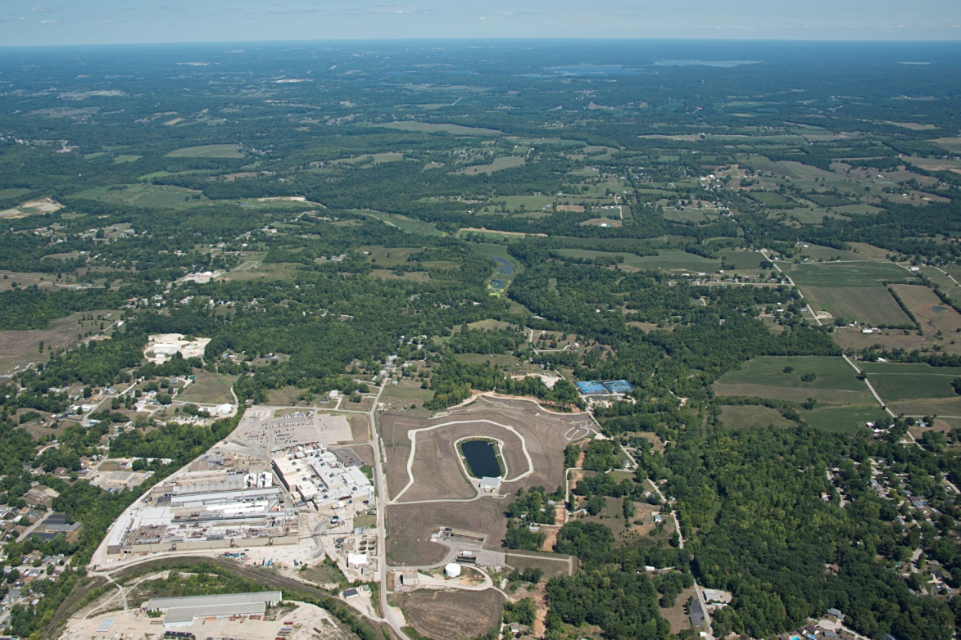
BEDFORD PLANT CORRECTIVE ACTION
Public Information Session
June 12, 2019
Facility located on 152.5 acres and is approximately 1,000,000 square feet of manufacturing footprint
Approximately 830 employees

Slide 2
REMOVAL ACTION
Comprehensive Environmental Response, Compensation, and Liability Act (CERCLA) Removal Action (RA)
  Bailey’s Branch and Pleasant Run PCB cleanup
  Control of impacted springs and seeps along creek
RCRA Corrective Action
  Conduct comprehensive RCRA Facility Investigation (RFI)
  Implement Interim Measures and Final Corrective Measures

Slide 3
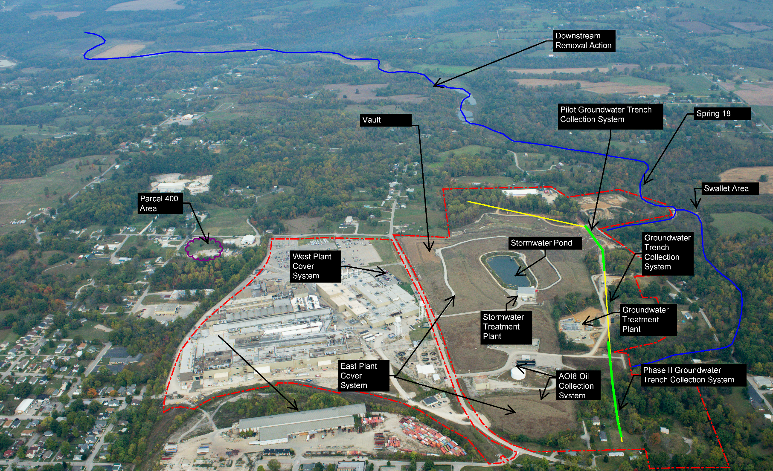
GM BEDFORD REMEDIATION PROEJCT

Slide 4
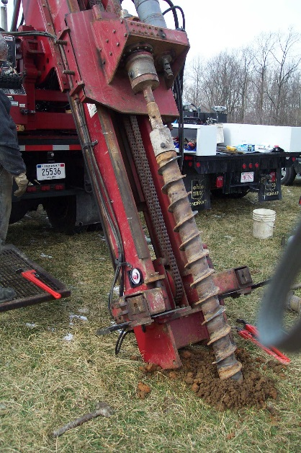
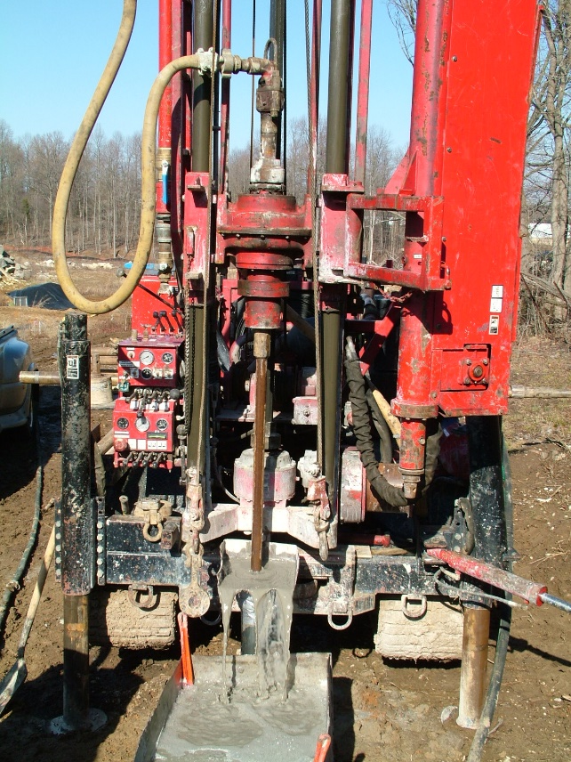
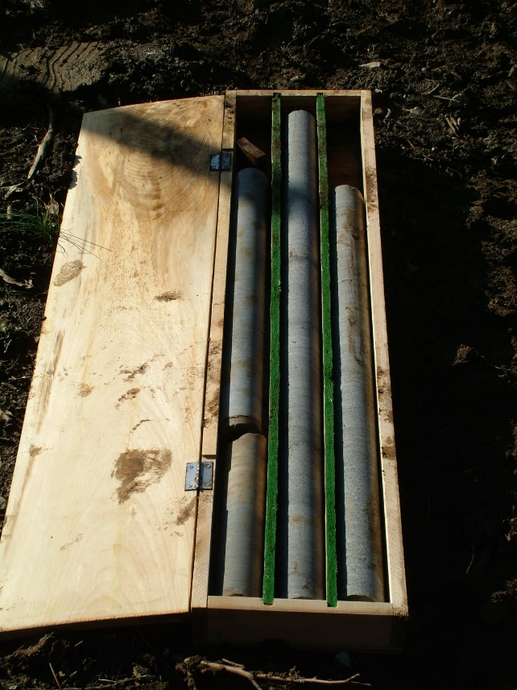
ON-SITE PILOT TRENCH MONITORING
Pilot groundwater trench construction was completed in August 2016 and has been operating since that time
Collects groundwater and conveys it to on-Site treatment system
Additional monitoring wells were installed and monitored to augment current monitoring groundwater monitoring network

Slide 5
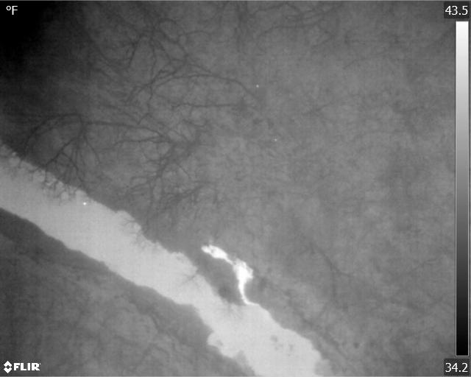
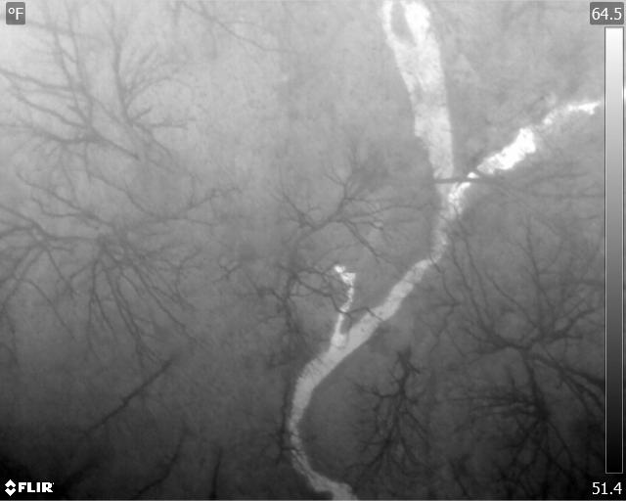
ON-SITE PILOT TRENCH MONITORING
Developing Pilot Trench Performance Monitoring Plan
A thermal study was conducted to identify groundwater seeps and springs (contrast in temperature)
Results will determine the location of monitoring points for the Plan

Slide 6
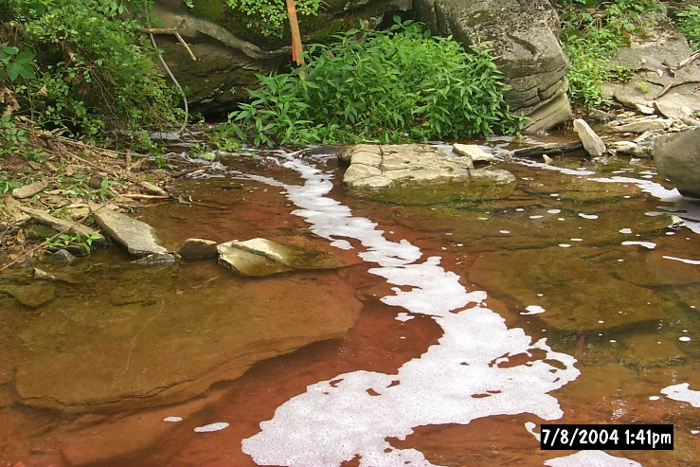
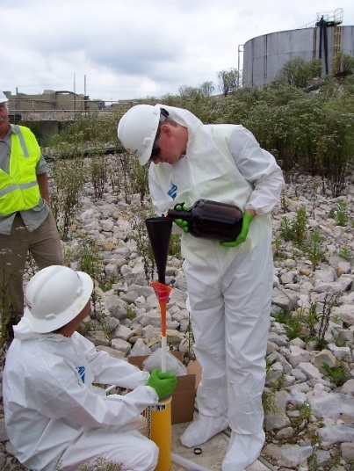
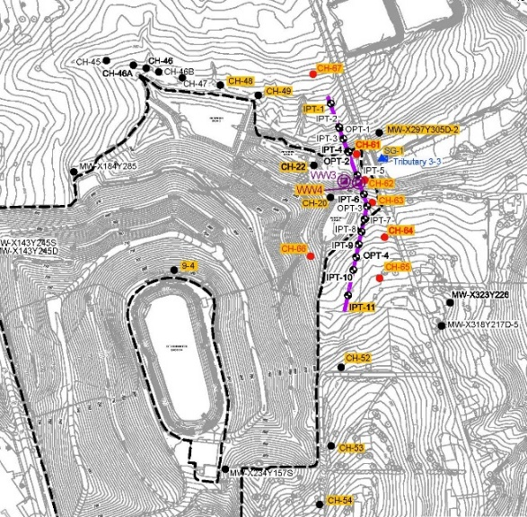
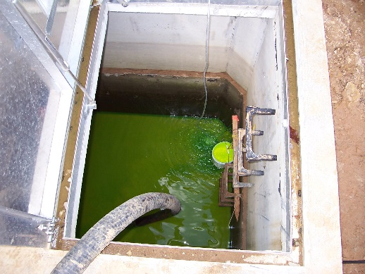
ON-SITE PILOT TRENCH MONITORING
A dye trace study will also be conducted to help define groundwater flow pathway
Will need some access to private properties to monitor seeps and springs

Slide 7
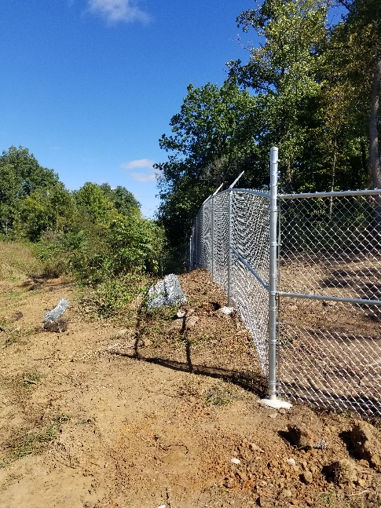
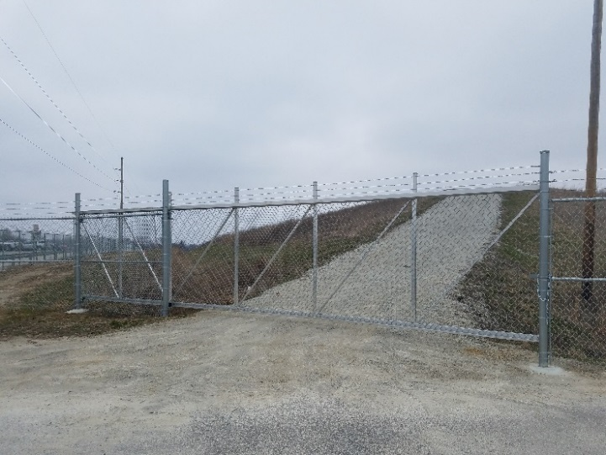
PLANT PERIMETER FENCE
East Plant Area fence installation has been completed.

Slide 8
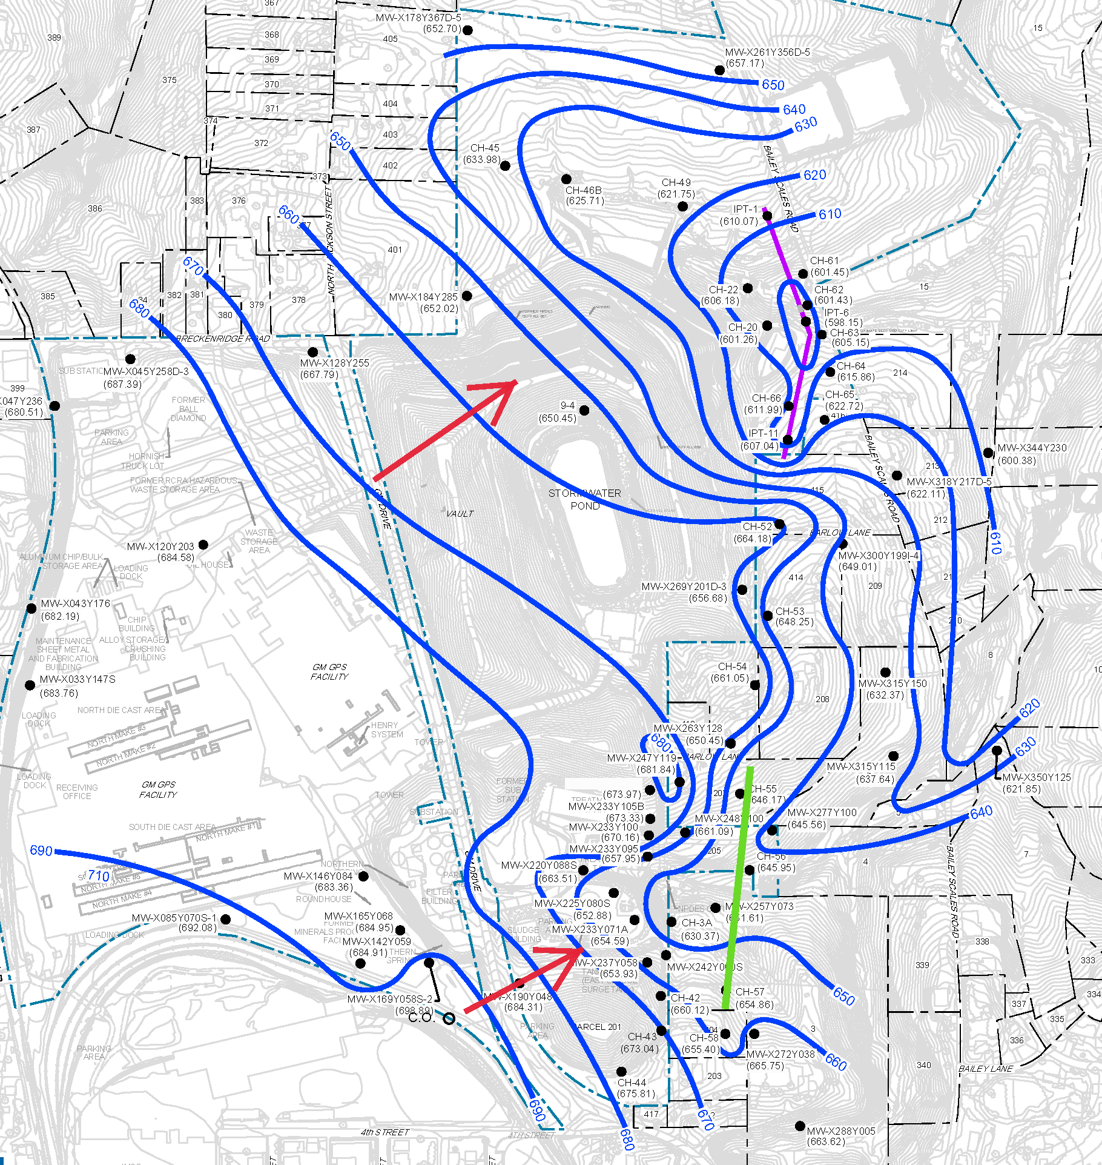
EI CA750 GROUNDWATER MONITORING
Quarterly groundwater level measurements collected
Groundwater sampling event conducted in May 2019
EI CA750 or pilot trench monitoring program will continue until a long term groundwater monitoring plan is in place

Slide 9
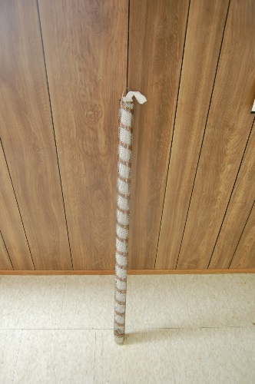
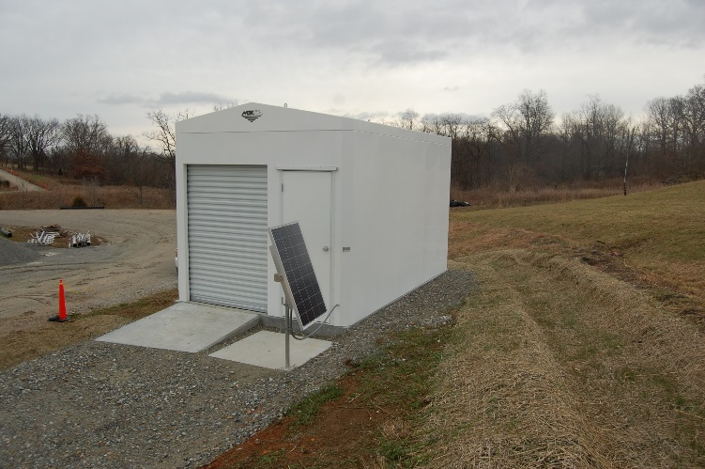
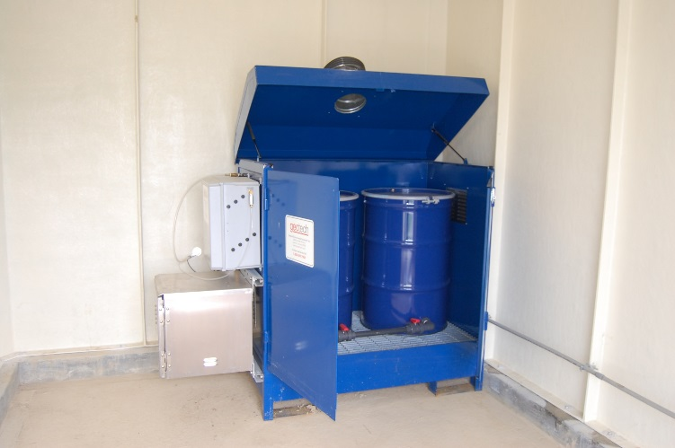
AOI 8 OIL COLLECTION SYSTEM
Active system uses solar power to collect oil from the ground
Passive oil recovery adsorbent socks are used where active oil recovery is not efficient
Oil collection began in October 2018
Additional oil manually removed from several other area wells

Slide 10
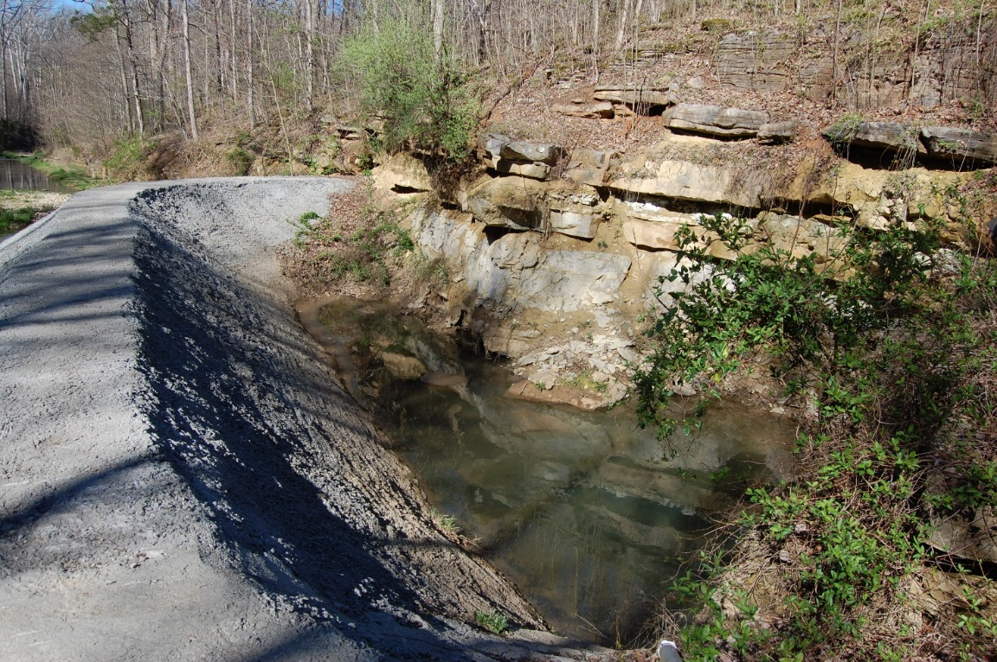
SPRING 18 MONITORING
GM will be presenting a report with Spring 18 sampling data to U.S.EPA for review
Three years of monthly (2017)/quarterly (2018)/semi-annual (2019) sample data shows no detectable PCB concentrations (reporting limit – 0.19 ug/L; Spring 18 action level - 0.3 ug/L).
Anticipate no additional sampling will be necessary

Slide 11
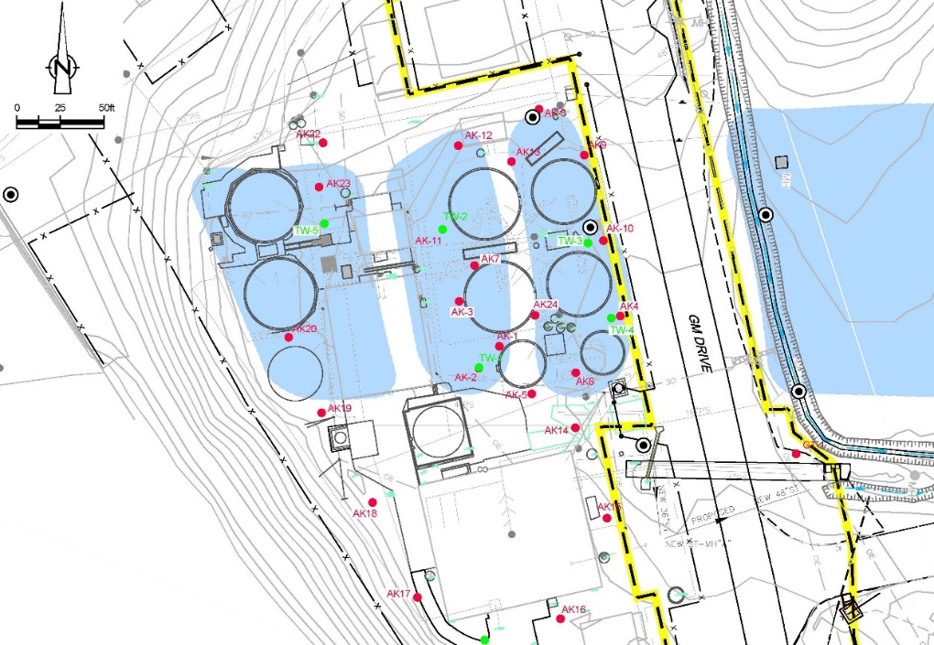
CLARIFIER SAMPLING PLAN
Additional wells were installed in the former clarifier area.
Data is being collected to support an assessment of potential current and future risks to human health and the environment.

Slide 12
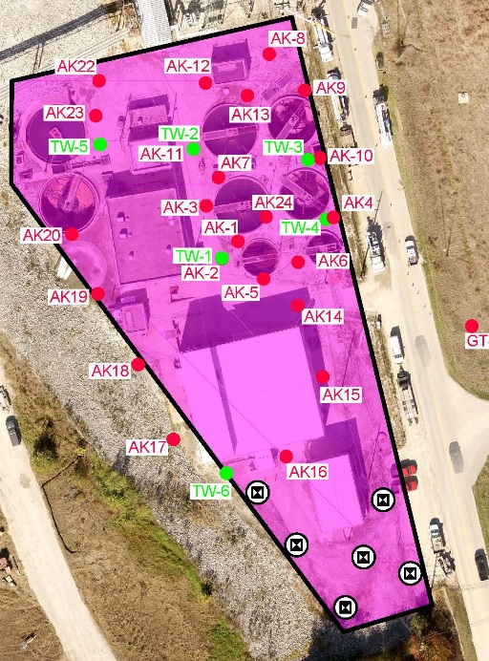
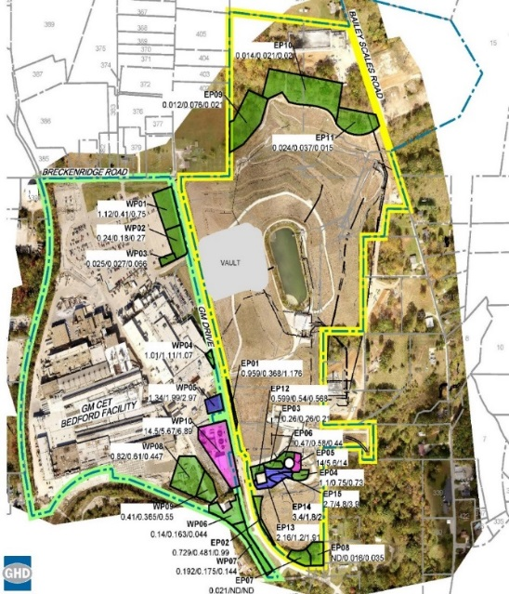
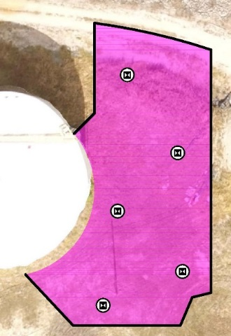
INCREMENTAL SOIL SAMPLING PLAN
Initial sampling targeted areas, not covered by East/West Plant Cover System, not currently paved with hard surface maintained by GM GPS.
Additional sampling was conducted in the two pink-shaded areas.
Data is being evaluated to identify areas which may pose a risk of exposure to site workers so that they will be protected.

Slide 13
PARCELS 400-430-431
Final delineation completed
GM will work with property owners on the prescriptive excavation plan
USEPA has reviewed the TSCA risk-based disposal approval request under 40 CFR 760.61(c)

Slide 14
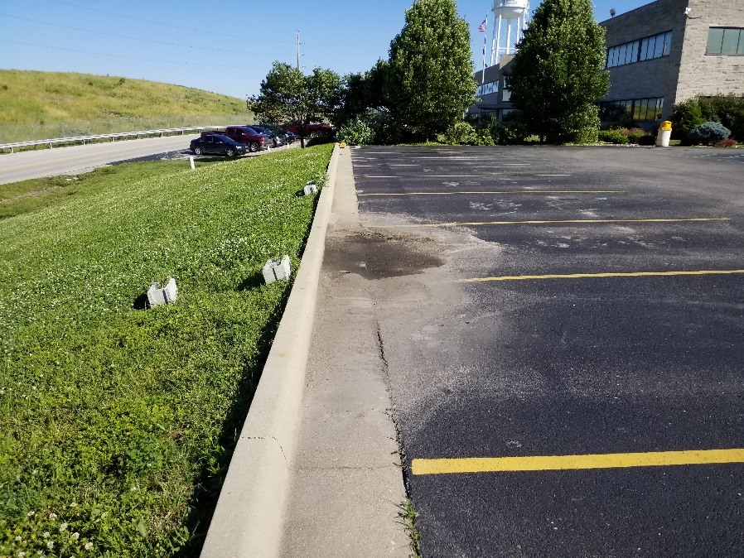
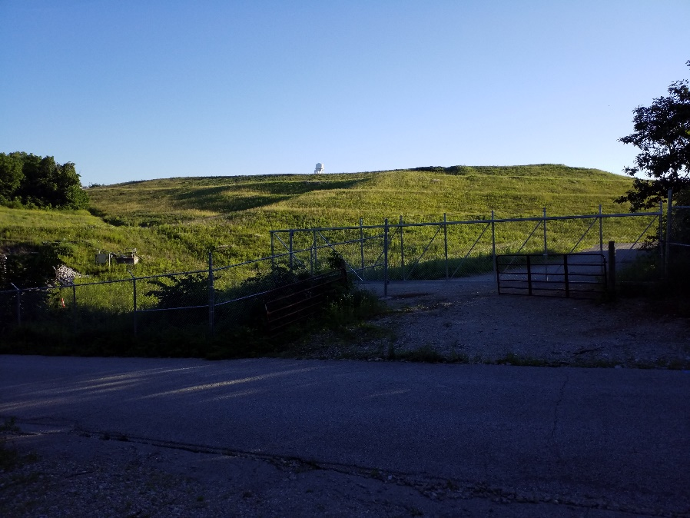
OPERATION, MONITORING, & MAINTENANCE
GM conducts quarterly inspections of the cover system
Cover system repairs are made, as needed

Slide 15
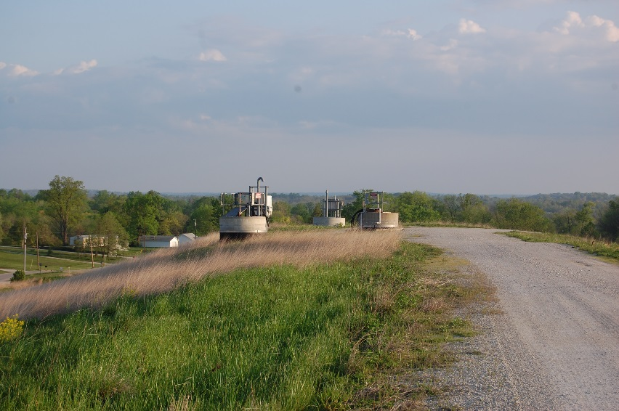
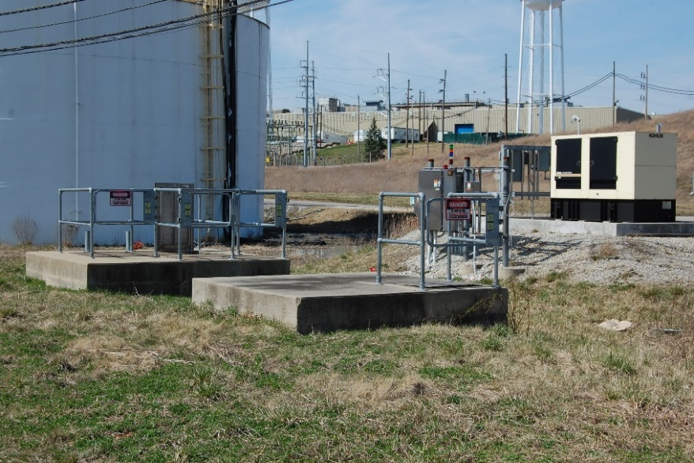
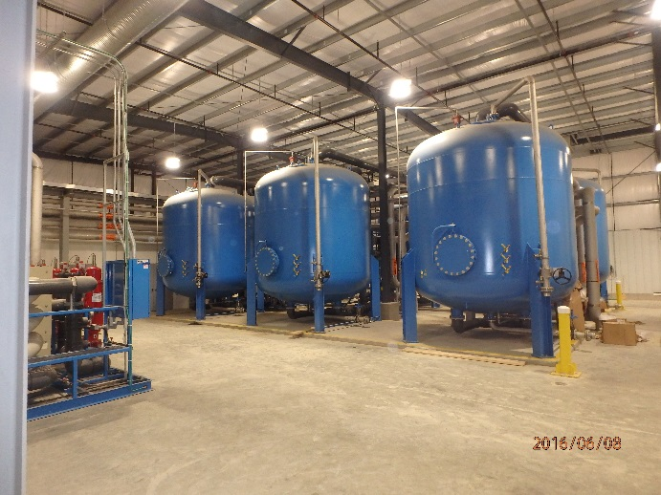
OPERATIONS, MONITORING & MAINTENANCE
Continued to monitor leak detection and leachate collection systems
Continue to operate SSC system
Continue to treat and discharge groundwater under the NPDES permit managed by GM Remediation

Slide 16
COMMUNITY RELATIONS ACTIVITIES
Community meetings have been held on a regular basis
The Community Liaison Panel and public meetings have been combined as project activities are winding down
Information from the presentations are posted to the website.
    http://www.BedfordPowertrainCorrectiveAction.com
Final approved documents can be found on the project website
Periodic information sessions
Periodic Project Fact Sheets
Project Questions contact Katie Kamm: (812) 277-8954

